Slide 1
WEST AFRICAN MEDIA
MIGRATION SUMMIT
LOME 2021
MIGRATION:
COMBATING ENSLAVEMENT OF AFRICANS THROUGH DECENT WORK
JUNE 22, 2021
AGORA SENGHOR, LOME-TOGO
HER EXCELLENCY
REV. DR. A. K. OCANSEY
PRINCIPAL MIGRATION CONSULTANT FOR THE GOVERNMENT OF SIERRA LEONE,
MEMBER, AFRICAN UNION LABOUR MIGRATION ADVISORY COMMITTEE,
FOUNDER AND CEO: NEKOTECH CENTER FOR LABOUR MIGRATION DIPLOMACY

Slide 2
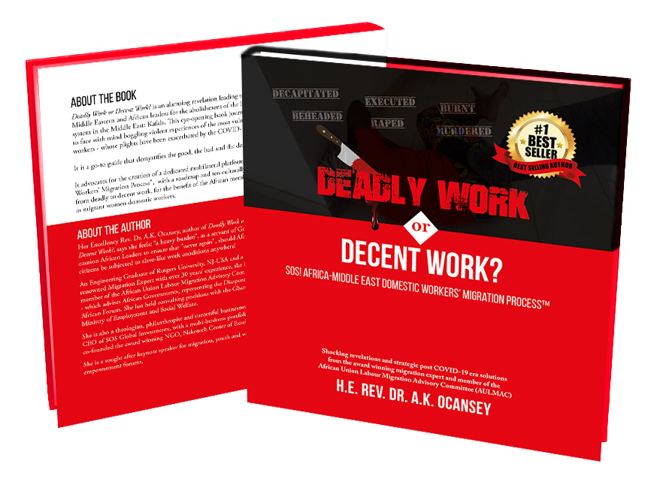

Slide 3
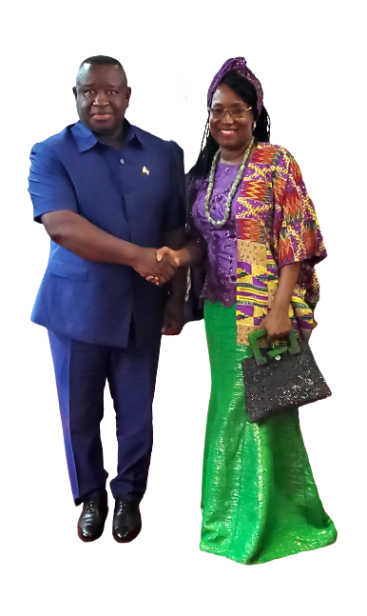
H.E. PRESIDENT DR. JULIUS MAADA, PRESIDENT OF SIERRA LEONE WITH H.E. REV. DR. A.K. OCANSEY

Slide 4
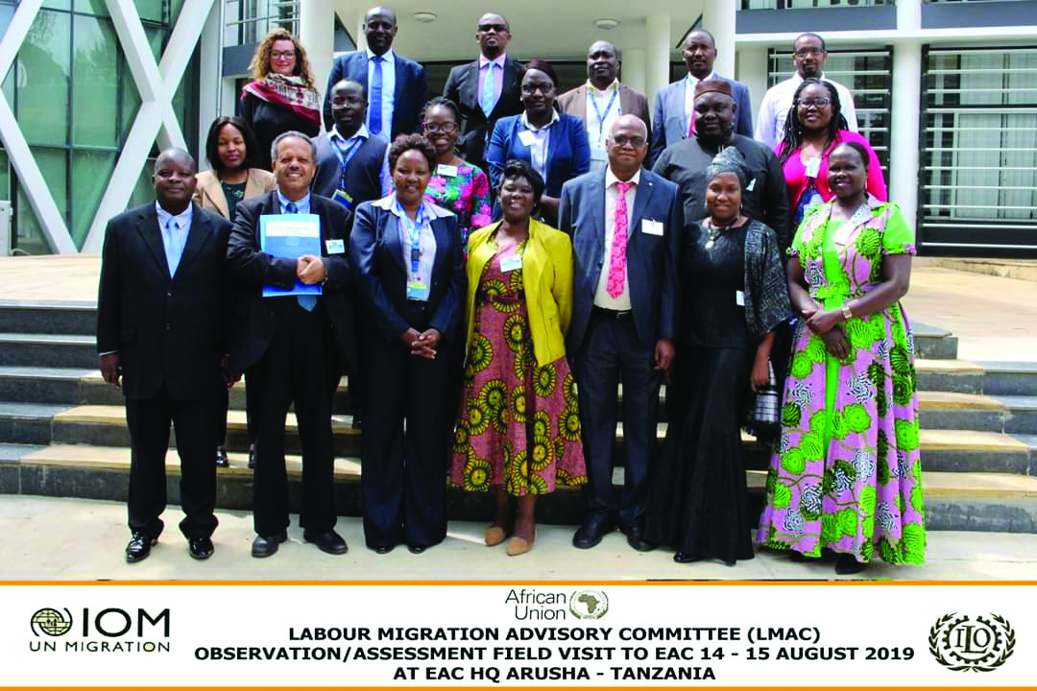


Slide 5

GYE NYAME
except for God’s intervention
^{Isaiah 1:17}
Learn to do right; seek justice.
^{Defend the oppressed.}
Take up the cause of the fatherless;
^{plead the case of the widow.}

Slide 6
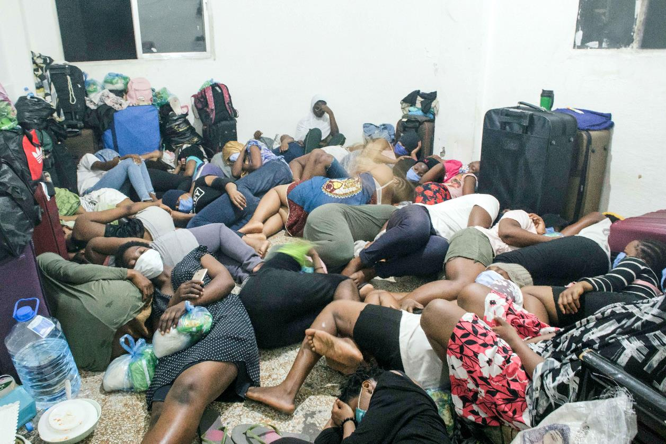
STRANDED AFRICAN WOMEN MIGRANT DOMESTIC WORKERS IN BEIRUT, LEBANON IN DETENTION CENTERS DURING COVID19 ERA

Slide 7
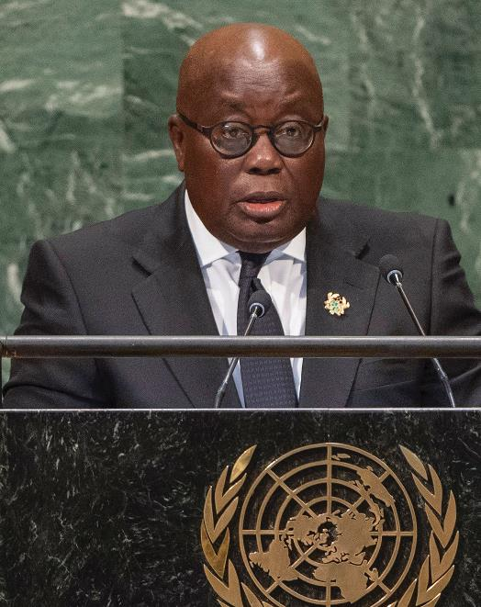
Nekotech Center for Labour Migration Diplomacy
PRESIDENTIAL CHAMPION
FOR SOS DECENT WORK 2020
Nekotech Center for Labour Migration Diplomacy
PRESIDENTIAL CHAMPION
FOR SOS DECENT WORK 2021
H.E. PRESIDENT NANA AKUFO-ADDO
President of the Republic of Ghana
H.E. PRESIDENT DR. JULIUS MAADA BIO
President of the Republic of Sierra Leone

Slide 8


Slide 9
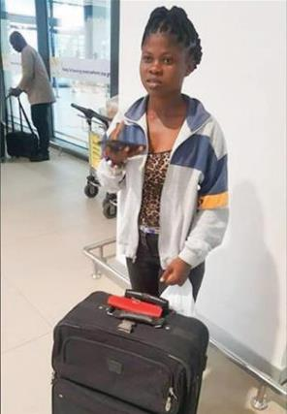
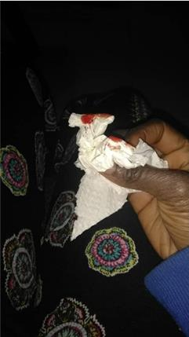
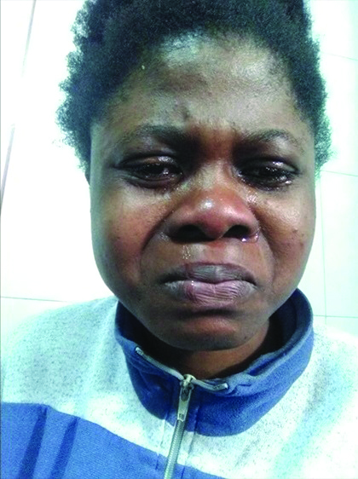
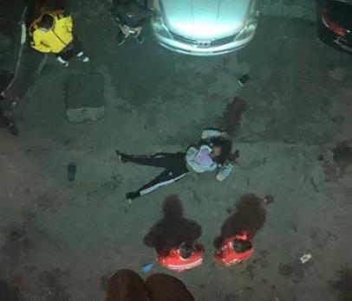
HALL OF APPEAL TO
STOP KAFALA
Spotlight on the late Faustina Tay
A Ghanaian domestic worker in Lebanon was found dead in the car park of her employer’s building, after she had made several urgent calls to her family and her agent to report continuous abuse and rape.
March 14, 2020
It is for the sake of the late Ms. Tay that we added “SOS (Save Our Souls)” to the subtitle of this book to reach all domestic workers in similar trouble.
This book is therefore a humble urgent call to action with game-changing prescriptions to save many precious young lives, like the late Ms. Tay’s.
Faustina leaving Ghana to Lebanon
Faustina’s nose bleed after being abused
Faustina in distress few days before her death
Faustina lying dead

Slide 10

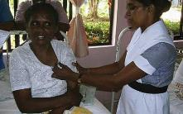

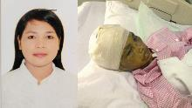

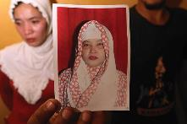

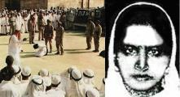
Name: Latifa
Country of Origin: Ghana
Country of Destination: Kuwait
Latifa Adams suffered constant abuse and subsequent severe burns after her employer’s children tampered with the kitchen stove leading to an explosion in the kitchen when she unknowingly turned on the stove. The employer’s delayed response to give her medical attention worsened her plight and her family demanded her return to Ghana.
Name: Joanna
Country of Origin: Philippines
Country of Destination: Kuwait
Her remains were found in a fridge in an apartment in Kuwait.
Name: Zamzam
Country of Origin: Ethiopia
Country of Destination: Saudi Arabia
She was executed for slashing the throat of her employer’s child as revenge for her mistreatments.
Name: Ariyawathi
Country of Origin: Sri Lanka
Country of Destination: Saudi Arabia
She returned from Saudi Arabia abused by her employer and with 24 nails in her body.

Slide 11
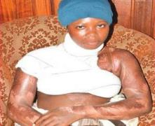
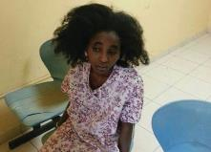


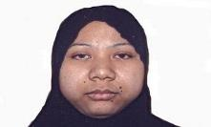
Name: Lensa
Country of Origin: Ethiopia
Country of Destination: Lebanon
She jumped off a second floor balcony and broke both her legs in an attempt to escape her abusive employers.
^{Name: Mary}
^{Country of Origin: Kenya}
^{Country of Destination: Jordan}
She was set ablaze by her employer and subsequently died from the burns.
Name: Sumiati
Country of Origin: Indonesia
Country of Destination: Saudi Arabia
She was beaten violently by her employer who also burned her head with hot iron and mutilated her with scissors, leaving her with internal bleeding.

Slide 12
HALL OF HOPE FOR
DECENT WORK

Slide 13








ATTRIBUTES OF DEADLY WORK versus DECENT WORK
Seized Passports
The right to keep their own passports
Protection against all forms of
sexual harassment
Sexual Harassment
Unpaid/ delayed/
reduced salaries
Regularly paid salaries
No day off
Regular weekly day off

Slide 14
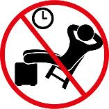







ATTRIBUTES OF DEADLY WORK versus DECENT WORK
Long working hours
with no rest periods
Daily rest of a
minimum of twelve hours
False accusations
leading to unjust
imprisonment
Access to proper conflict resolution mechanisms with
counselling and mediation services
Executions without
prior diplomatic
discussions with
the sending country
No executions.
Deportations are preferred
Access to a mobile phone and thirty days paid annual leave
Slave-like conditions

Slide 15
Major 10 African Sending Countries to the Middle Eastern
Receiving Countries in Descending Order
^{Country} | ¹⁹⁹⁰ | ¹⁹⁹⁵ | ²⁰⁰⁰ | ²⁰⁰⁵ | ²⁰¹⁰ | ²⁰¹⁵ | ²⁰¹⁷
^{Egypt} | ^{700,369} | ^{732,802} | ^{812,226} | ^{1,052,392} | ^{1,760,225} | ^{2,374,997} | ^{2,479,365}
^{Sudan} | ^{252,683} | ^{266,270} | ^{289,303} | ^{342,971} | ^{493,680} | ^{538,690} | ^{656,875}
^{Ethiopia} | ^{67,206} | ^{69,158} | ^{72,058} | ^{87,713} | ^{117,755} | ^{138,123} | ^{165,603}
^{Eritrea} | ^{8,141} | ^{8,702} | ^{10,428} | ^{12,686} | ^{24,194} | ^{26,045} | ^{27,070}
^{Nigeria} | ^{3,075} | ^{3,231} | ^{3,814} | ^{7,891} | ^{18,219} | ^{24,864} | ^{25,965}
^{South Sudan} | ^{5,081} | ^{6,433} | ^{7,990} | ^{8,735} | ^{17,190} | ^{14,425} | ^{20,010}
^{Somalia} | ^{5,138} | ^{5,553} | ^{6,793} | ^{7,415} | ^{13,267} | ^{10,930} | ^{14,535}
^{Morocco} | ^{5,099} | ^{5,467} | ^{6,268} | ^{6,582} | ^{11,691} | ^{12,372} | ^{13,704}
^{Tunisia} | ^{2,568} | ^{2,744} | ^{3,266} | ^{3,955} | ^{7,538} | ^{8,646} | ^{9,023}
^{Chad} | ^{12,557} | ^{11,440} | ^{9,300} | ^{5,790} | ^{6,693} | ^{7,156} | ^{7,488}

Slide 16
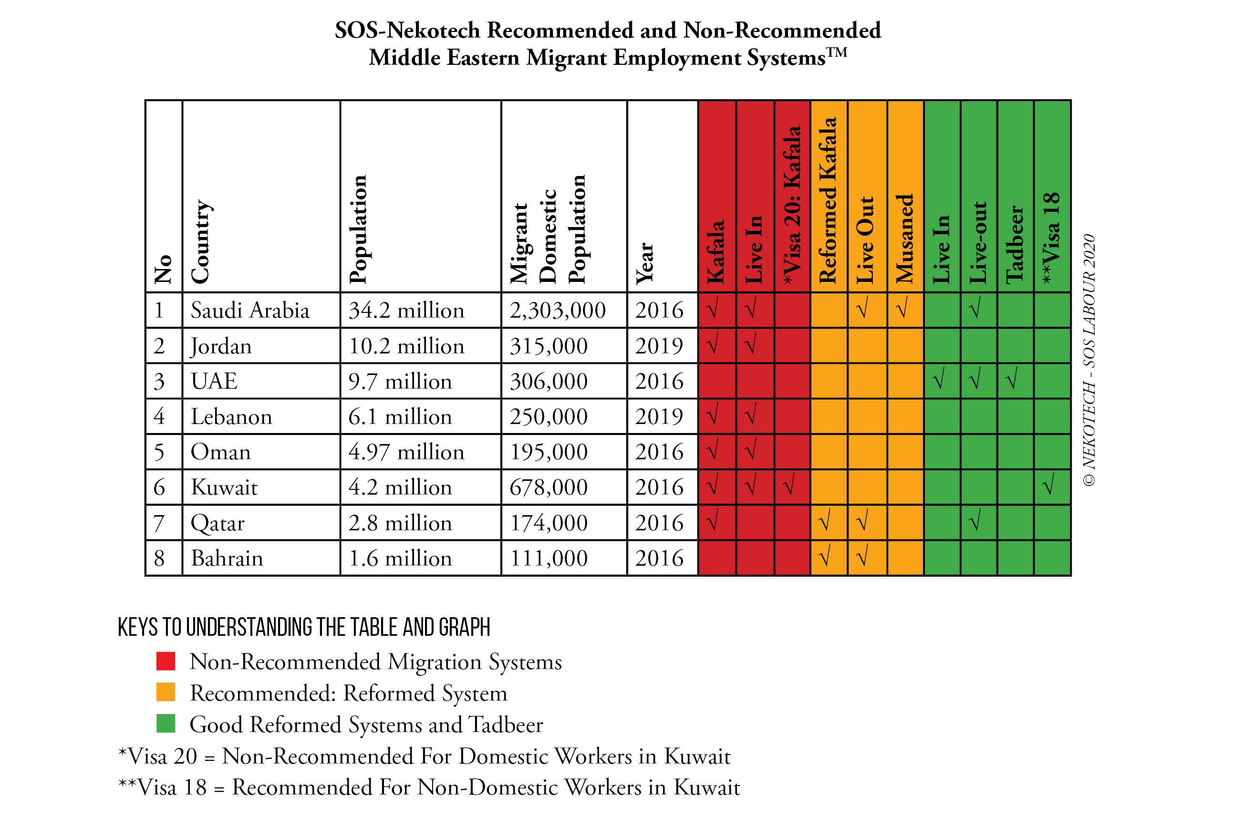

Slide 17
SUMMARY OF LABOUR MIGRATION BANS
^{SENDING COUNTRIES} | ^{YEAR} | ^{REASON MIGRANT} | ^{HIRING SYSTEM USED}
^{Ethiopia} | ^{2013, 2018} | Migrant Women Domestic Workers Abused | ^{Kafala}
^{Kenya} | ²⁰¹⁴ | Migrant Women Domestic Workers Abuse | ^{Kafala}
^{Uganda} | ²⁰¹⁶ | Migrant Women Domestic Workers Abuse | ^{Kafala}
^{Ghana} | ²⁰¹⁷ | Migrant Women Domestic Workers Abuse | ^{Kafala}
Sierra Leone | 2019 – 2021 | Migrant Women Domestic Workers Abuse | Kafala

Slide 18
10
KEYS TO
DEADLY2DECENT WORK DIALOGUE

Slide 19



ADINKRA SYMBOL | RECOMMENDATIONS
01 DIALOGUE & AGREEMENT | The SOS Africa-Middle East Domestic Workers’ Migration Process is due. Considering the urgency of the issues pertaining to African migrant abuse, specifically, domestic workers in the Middle East, we recommend that the African Union consider inviting the Middle East for the joint initiation of the SOS! African-Middle East Domestic Workers’ Migration Process to enable them to come up with mutually beneficial migration processes for the betterment of both regions with joint post COVID-19 protocols training framework.
02 AWARENESS | Increase Migrant Women’s Advocacy and Awareness-Raising Programs There must be more women’s advocacy and awareness-raising on the dangers of illegal migration and on proper channels for decent work in the countries of origin- especially to receiving countries that have bilateral labour agreements with African sending countries.
03 COOPERATION | Ratify Women-Sensitive Bilateral Labour Agreements Governments of both sending and receiving countries must take joint responsibility-paying a special attention to women migrants – which must be reflected in Bilateral Labour Agreements –to provide a women-sensitive legal migration framework for safe and equitable migration to provide decent work for women.

Slide 20



ADINKRA SYMBOL | RECOMMENDATIONS
04 INTER-DEPENDENCE | Develop Women’s Human Rights Sensitive Foreign Employment Policy Governments must develop and implement foreign employment policies that recognize and protect the rights of women migrant workers as well as support advocacy for national economic and social policies and legislation. Capacity building and information flow must be supported by Government to women’s organizations for full dissemination of information.
05 SAFETY | Implement, Monitor and Evaluate Foreign Employment Policies Governments must not only ensure these policies are duly implemented, but they must also be monitored and evaluated and continuously improved upon. Embassies must consider appointing Labour Attachés for routinely overseeing the welfare of the migrant workers, especially domestic women workers.
06 LAW & ORDER | Ban Illegal Recruitment Agencies not Legal Migration Governments must seek to ban illegal migration agents and to set severe consequences for those caught in trafficking rings. Banning of legal Migration automatically boosts illegal Migration businesses. Therefore Governments must seek other forms of redress and choose bans as a last resort. Women are most vulnerable during bans and easily fall prey to illegal operators.

Slide 21



ADINKRA SYMBOL | RECOMMENDATIONS
07 QUALITY RECRUITMENT | Regulation of Private Employment Agencies for Quality Recruitment Governments must endeavour to regulate private employment agencies to perform ethical and high quality recruitment processes by providing orientations for them. Governments must advertise who the oriented private employment agencies are to the general public to prevent illegal agencies from operating in the domestic worker sector.
08 CERTIFICATION & SETTLEMENT | Training of Low Skilled Rural Women & Overseas Employers Receiving countries can contribute to the soft and hard skills training of visa holding low skilled women and to ensure each is immersed in the Nekotech COVID-19 Certified Program prior to departure. This will help reduce abuse, command respect for their professional competencies and help the African migrants earn wages comparable to their colleague migrants. Employers in receiving countries must also undergo orientation to put them in compliance with the terms and conditions of the BLA.
09 RETURN & REINTEGRATION | Facilitation of Renewal or Return & Re-Integration Programs for Migrants Governments can jointly facilitate contract renewal or return and re-integration programs for a smooth resettlement for migrants participating in short and long term migration programs, especially for the women to enter into local trades or projects. These returnees can also be employed as local trainers of trainers for new migrants looking to go overseas to work as domestic workers.

Slide 22

ADINKRA SYMBOL | RECOMMENDATIONS
10 FINANCIAL SECURITY | Empowerment of Migrant Women through Innovative Financial Products Short term legal migration boosts women’s economic empowerment by encouraging women to own a bank account and opening the door for them to have access to innovative financial services which could benefit them and their local banks. Banks may also offer inexpensive money transfer schemes as well as investment or savings products with financial literacy training prior to migrants’ departure together with their families on how to leverage remittances.

Slide 23
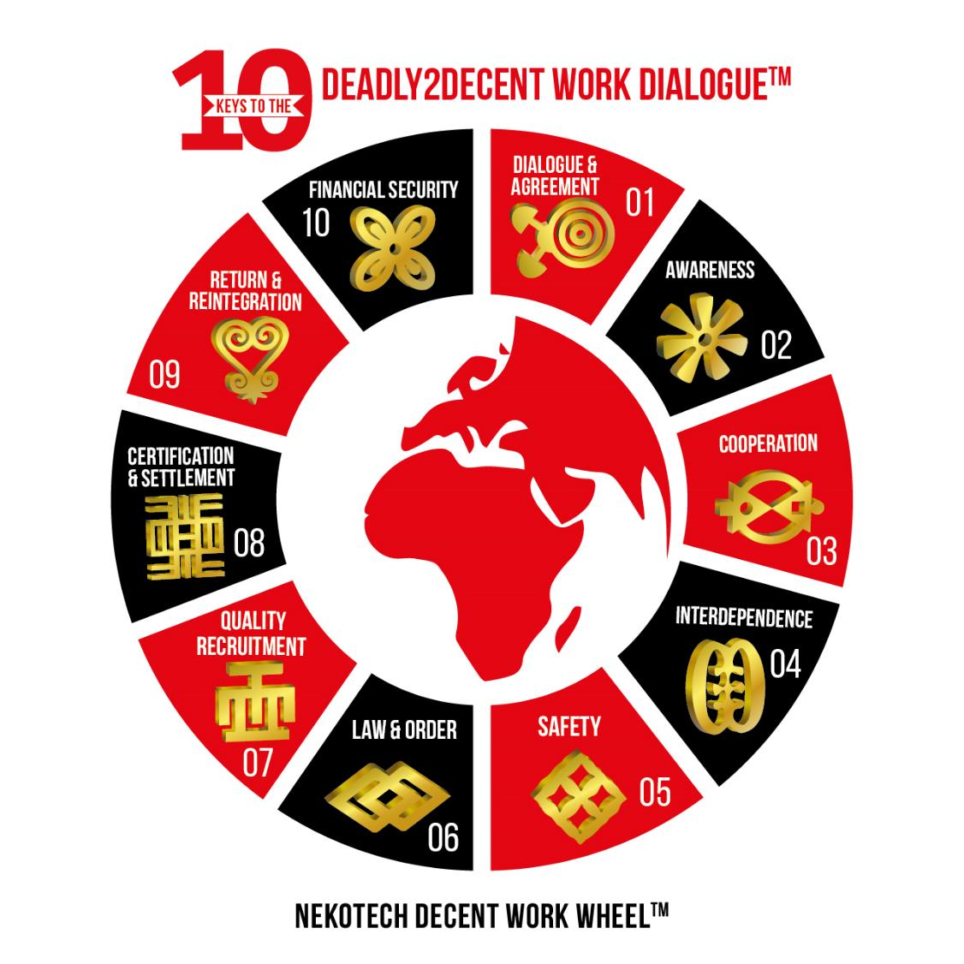

Slide 24
SOS! AFRICA-MIDDLE EAST DOMESTIC WORKERS’ MIGRATION PROCESS™ TO COMBAT ENSLAVEMENT OF AFRICANS THROUGH DECENT WORK
Name of Process | SOS! Africa-Middle East Domestic Workers’ Migration ProcessTM
Recommended Year of Formation | 2021/2022
Proposed Members | AU Main Sending Countries of Origin of African Migrants, African Union Member States, RECs, and Middle Eastern Main Receiving Countries - GCC, Lebanon, Jordan and Malaysia. Observers: AU-LMAC, representatives of GCM, ILO, IOM, IDWF and the Colombo Process, UN Women, Trade Unions and selected Civil Societies, Women’s Organizations, Recruitment Agency Associations and GCC Diaspora Human Rights NGOs.
Summary of Purpose | The SOS! Africa-Middle East Domestic Workers’ Migration ProcessTM will be a multilateral consultative dialogue forum which will look to urgently facilitate safe labour migration and adequate protection for African migrant workers, especially female domestic workers, by the elimination of abusive migrant worker systems like Kafala and jointly reviewing decent migrant labour reformed systems for adoption and implementation. This is the roadmap to combating enslavement of Africans through decent work.

Slide 25
THANK YOU

